Slide 1
Final Project Presentation- Usable AI
Time series analysis on Grocery sale trends
By :
Mitali Tavildar & Shefali Luley

Slide 2
Problem Statement
To understand different time series models and apply them on the groceries dataset.
The data consists of details of purchase and variety of grocery items over time .
The aim to utilize this dataset to predict the demand for these different products in future.
.
Column name | Number of rows | Dtype
Member number | 38765 | integer
Date | 38,765 | object
Description of items | 38,765 | object
Notes:
The main goal of our project is to implement time series models on the groceries dataset since we didn’t have any hands on experience with it.
Our aim is to leverage the vast amount of data on groceries, including purchase details and various product types, to accurately forecast future demand. This valuable insight will enable us to optimize inventory management and enhance efficiency for distributors, ultimately leading to improved operational performance.
As you can see from the table, the dataset consists of 3 column : Member_number, date and description of items.

Slide 3
Data Description and Observations:
Member_number: Unique id of the customer which is of the datatype ‘int’.
Date: Provides the date of purchase for the corresponding commodity. This is of the data type ‘object’
itemDescription: It is the description/name of the commodity being purchased. This is in text format with the datatype ‘object’.
The data we have covers commodities purchased for the year 2014 and 2015.
Notes:
Here is the description of columns :
The member_number is the unique id of each customer , with datatype as “int”, the date provides the date of purchase for the corresponding commodity and the item description consists of the products purchased in that commodity. The datatype for both of them is “object”.
Observations tells us that the data consists of two years i.e. 2014 and 2015

Slide 4
Feature Engineering and Statistics
In itemDescription , there are 167 total unique products.
We engineered a new column called ‘Category’ that broadly described the kind of the product. For example, ‘chicken’, ‘beef’ and ‘sausage’ would be classified as ‘Meat’.
Number | Category | Count
1 | Dairy | 5725
2 | Beverages | 5083
3 | Vegetables | 4572
4 | Meat | 4313
5 | Sweets | 4064
6 | Bakery | 3417
7 | Fruits | 3167
8 | Condiments | 2910
9 | Kitchen supplies | 2006
10 | Misc products | 1913
Notes:
The item description column consists of 167 unique products.
Here, we engineered a new column called “Category” (randomness in data) which describes the product lies in which category
For eg : Chicken, beef and sausage are classified as “Meat” .
In feature engineering further, since we had 2 years of data, there were few dates in the Date column which were missing and indicated that no purchase was done .
So we filled in those dates using reindexing and the count value here was zero.

Slide 5
Exploratory Data Analysis

Slide 6
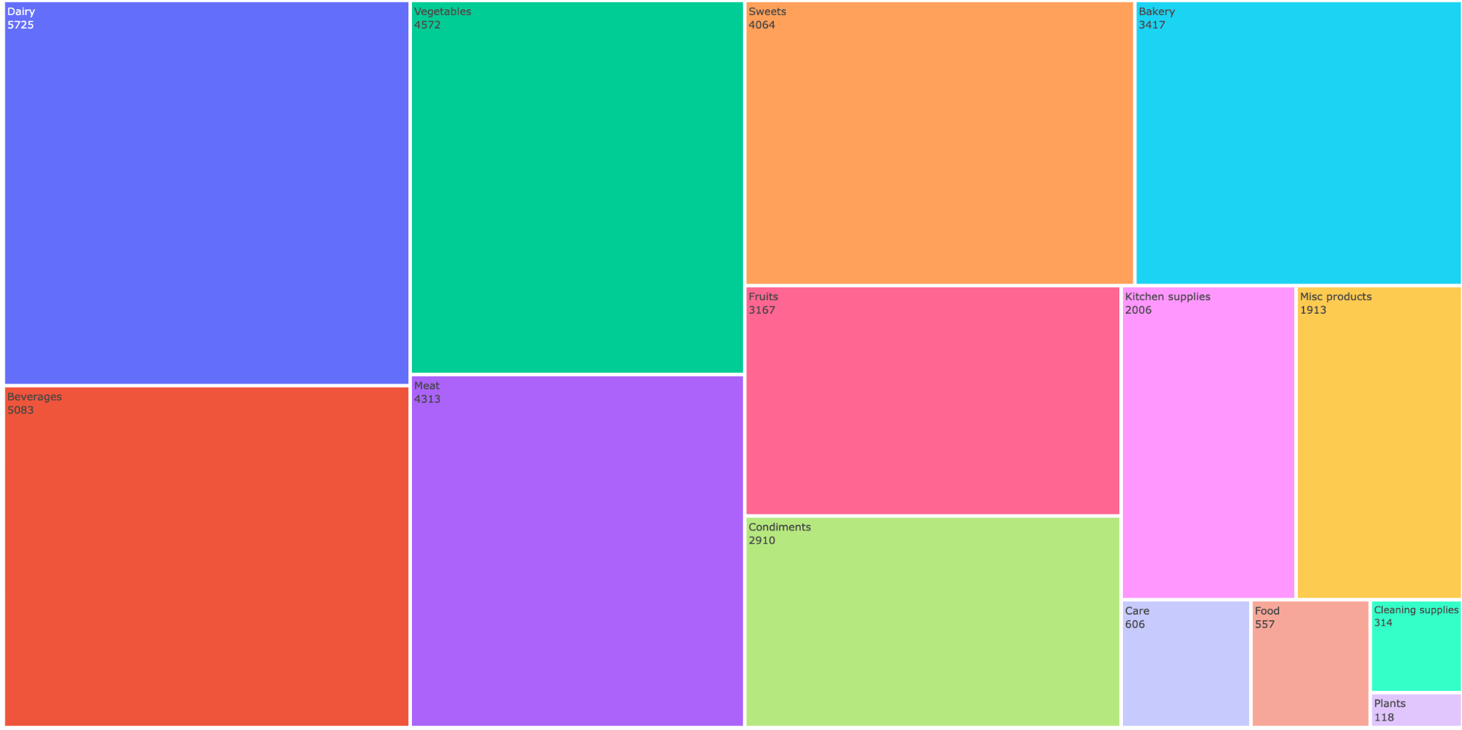
Frequency of the categories in terms of items sold
Notes:
Here, we have plotted the frequency of the categories in terms of the sold items.
As you can observe the above treemap , it shows “Diary” [5725] having the highest frequency followed by Beverages.
In contrast to that, the categories of "Cleaning Supplies" and "Plants" are in the region with the least frequencies.

Slide 7
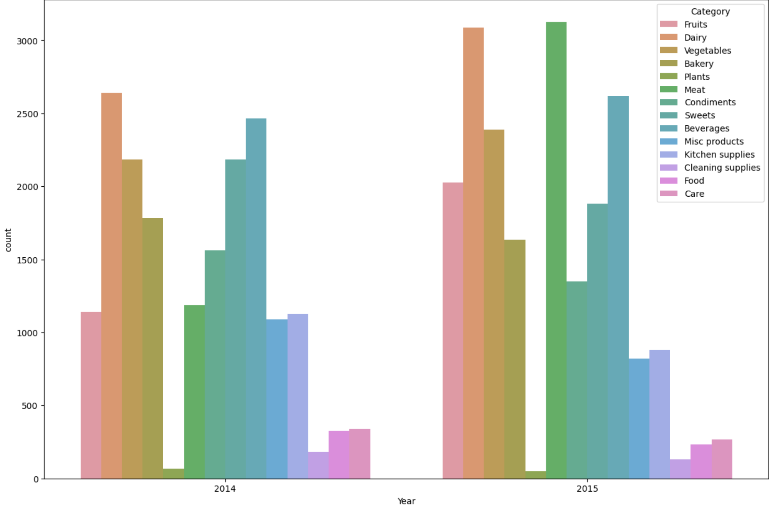
Comparison of years 2014 and 2015 with respect to categories
Notes:
-Here is the yearly demand for each categories in the years 2014 and 2015
- The above countplot indicates that the “meat” is highest in demand in 2015 while, “diary” is the second highest in 2015 and highest in “2014”

Slide 8
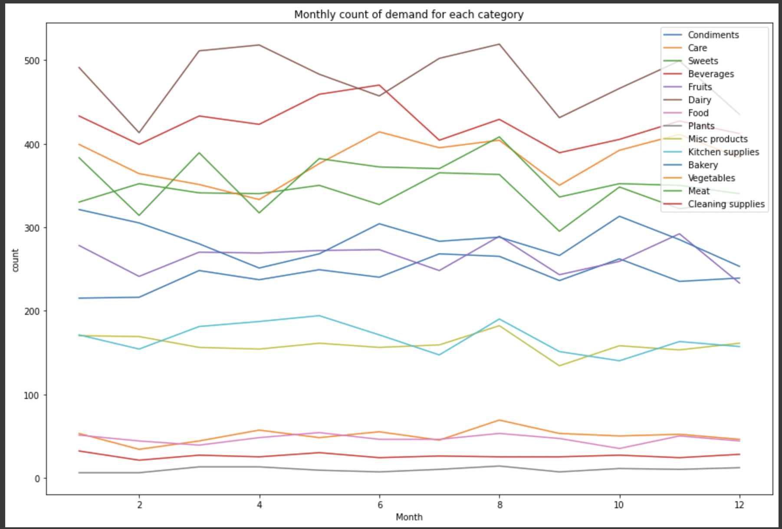
Monthly count for each category
Notes:
The above graph focuses on analyzing the monthly trends in demand for each category.
Observations suggest a significant variation in the range of counts of each category.

Slide 9
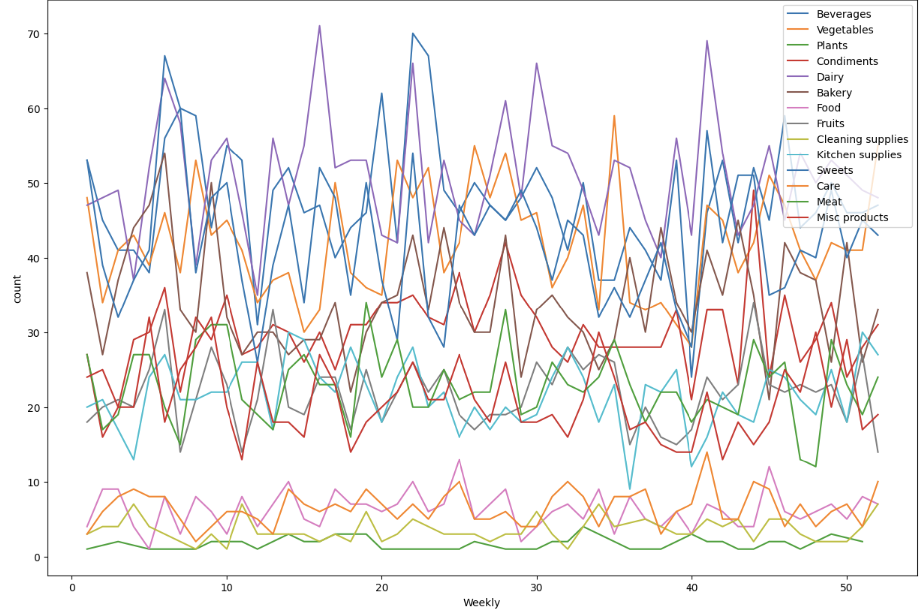
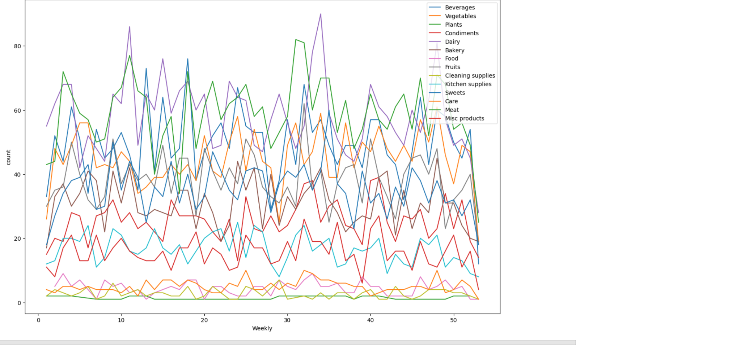
Weekly count for demand for each category in 2014 and 2015
Notes:
- The above figures shows a more in-depth analysis of the weekly demand for each category, plotted over two years.
- The first Figure illustrates the demands for the year 2014, while the second represents the demands for the year 2015.
- It can be observed that some categories overlap, and we observe similar demand trends for these categories.

Slide 10
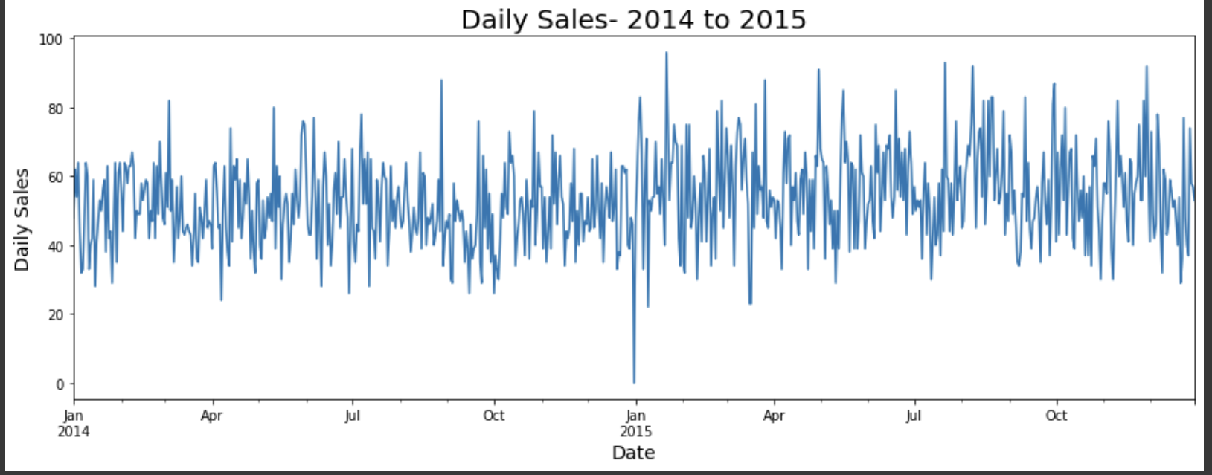
Variation in demand of different categories on daily basis
Notes:
- The graph above indicates a consistent pattern in daily sales from 2014 to 2015, with the exception of a dip in January 2015.
- The cause of this dip is uncertain and may be attributed to various factors such as inflation, among others.
- Here were the results and analyzes we used to visualize the data monthly , daily and yearly

Slide 11
Time Series Analysis

Slide 12
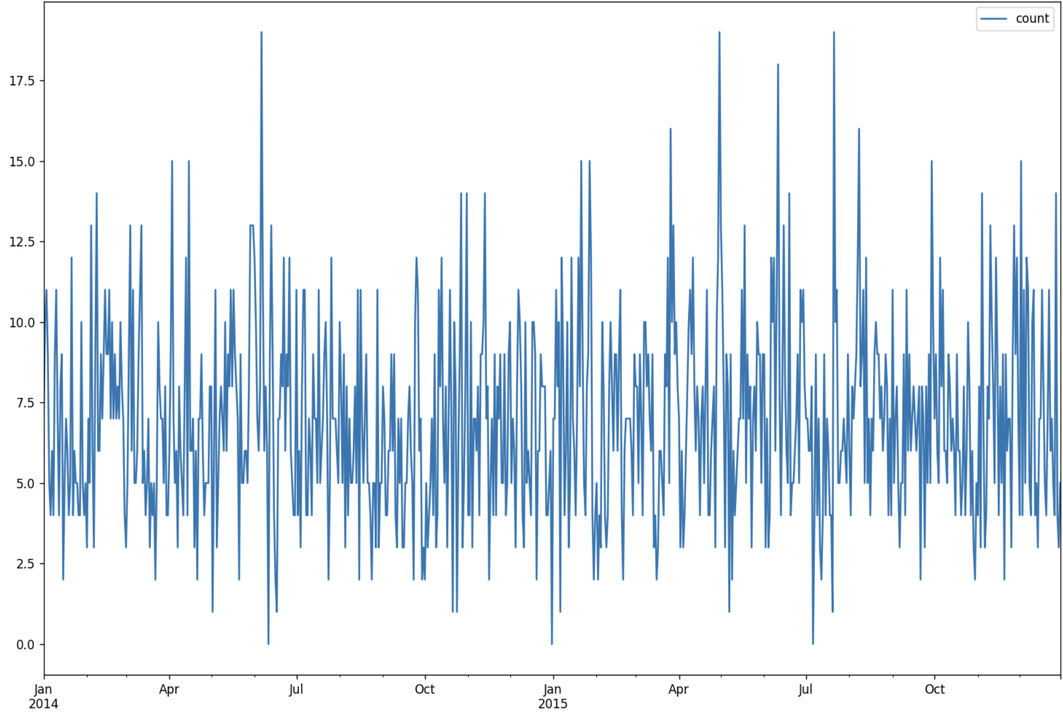
Sales distribution for Beverages on daily basis

Slide 13
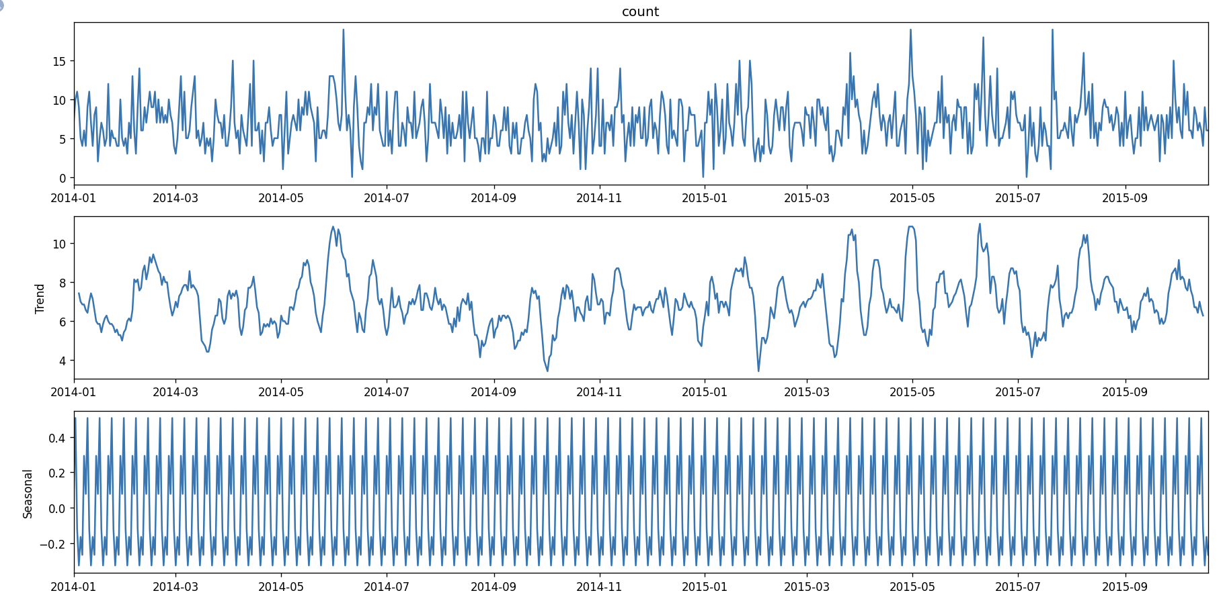
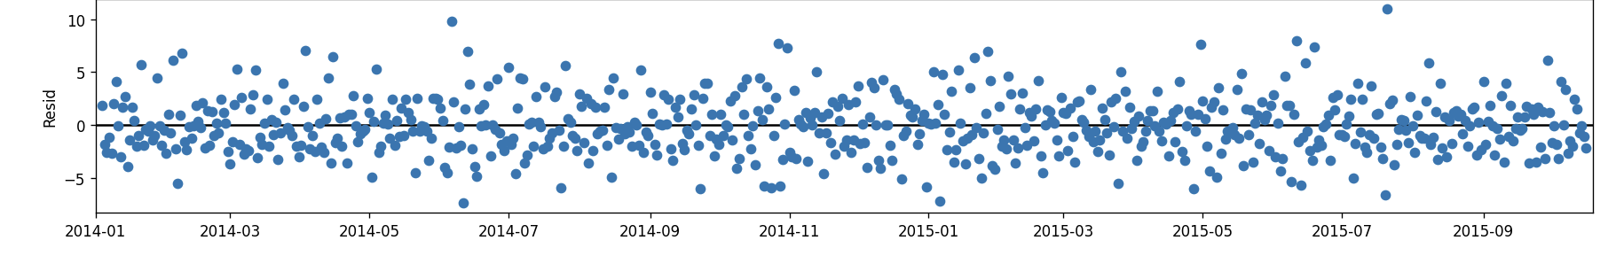
Decomposition
Notes:
trend — the general direction of the series over 24 months(2 years) for all the data items present
seasonality — a distinct, repeating pattern observed in regular intervals due to various seasonal factors, which was daily in our case
residual — the irregular component consisting of the fluctuations in the time series after removing the previous components

Slide 14
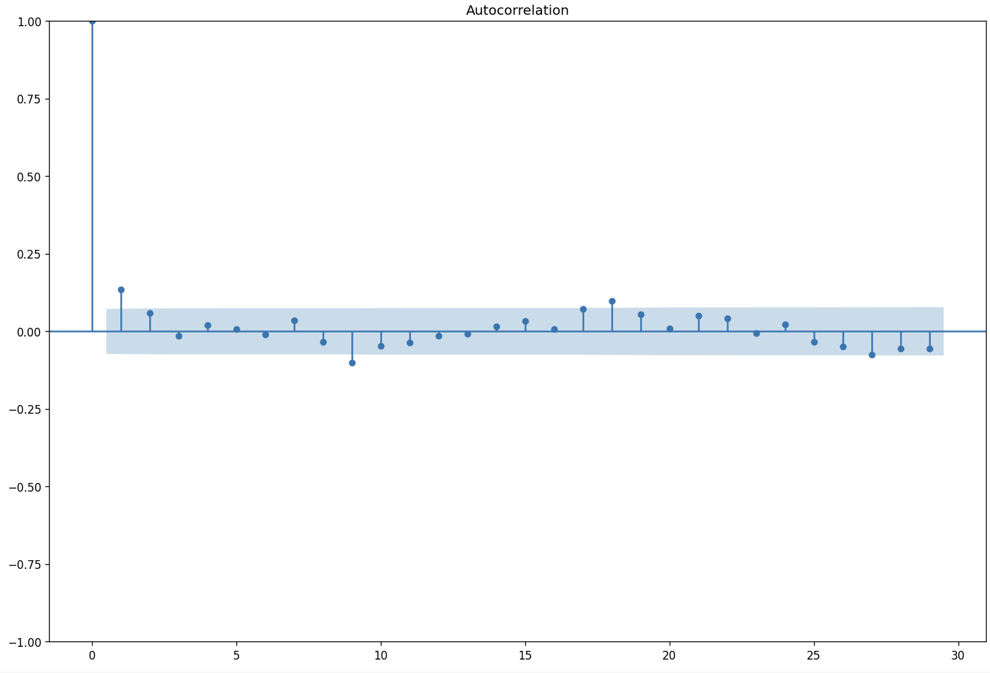
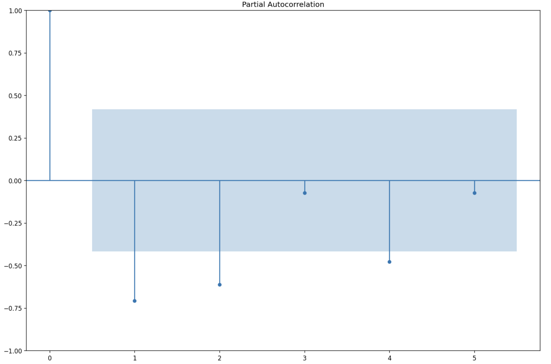
Visualizing Hyperparameters p and q
ADF Test statistics:-
ADF statistic | p-value
-21.795225 | 0.0000
Notes:
-p,q,m,d
P: Is the number of AR terms (lags of the stationarize series , in the forecasting equation are called AR term)
D : number of non seasonal differences( time series need to be differentiated to be made stationary is said to be “I”)
Q: is the number of lagged forecast errors in the prediction(lag of the forecast errors are called MA terms)
Plotted pacf and acf graphs
-m : 7 (7 days a week)
Our test statistic, p value was zero indicating no need of further processing the data.We did not observe a periodic component in the data, so transformations will not be necessary to make the data stationary.

Slide 15
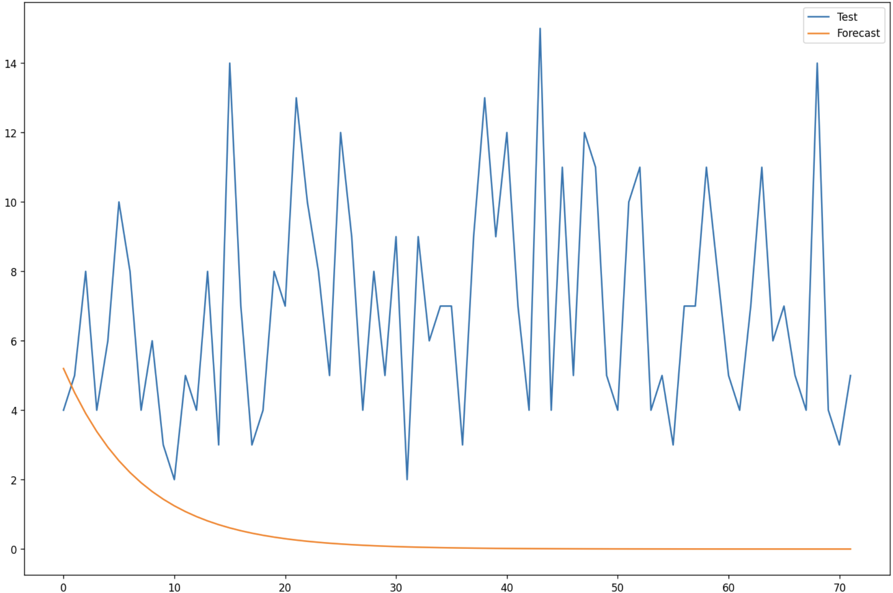
Prediction from preliminary model
Count
RMSE | 7.363
Days

Slide 16
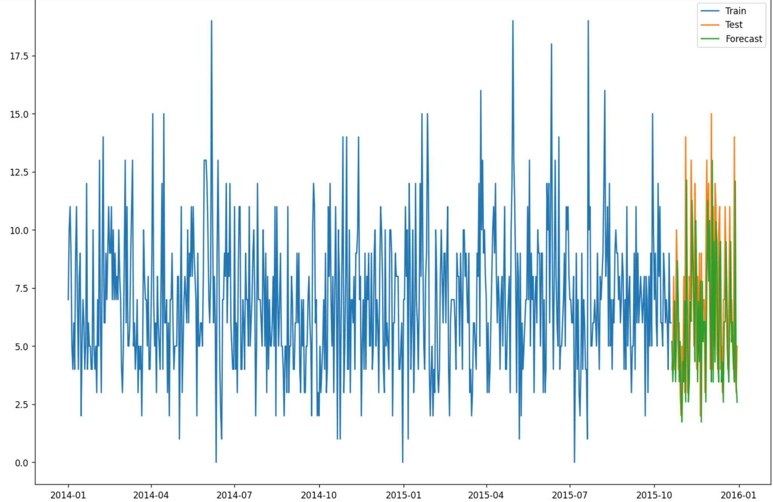
Predictions from Walk Forward optimization
Count
RMSE | 4.469
Dates

Slide 17
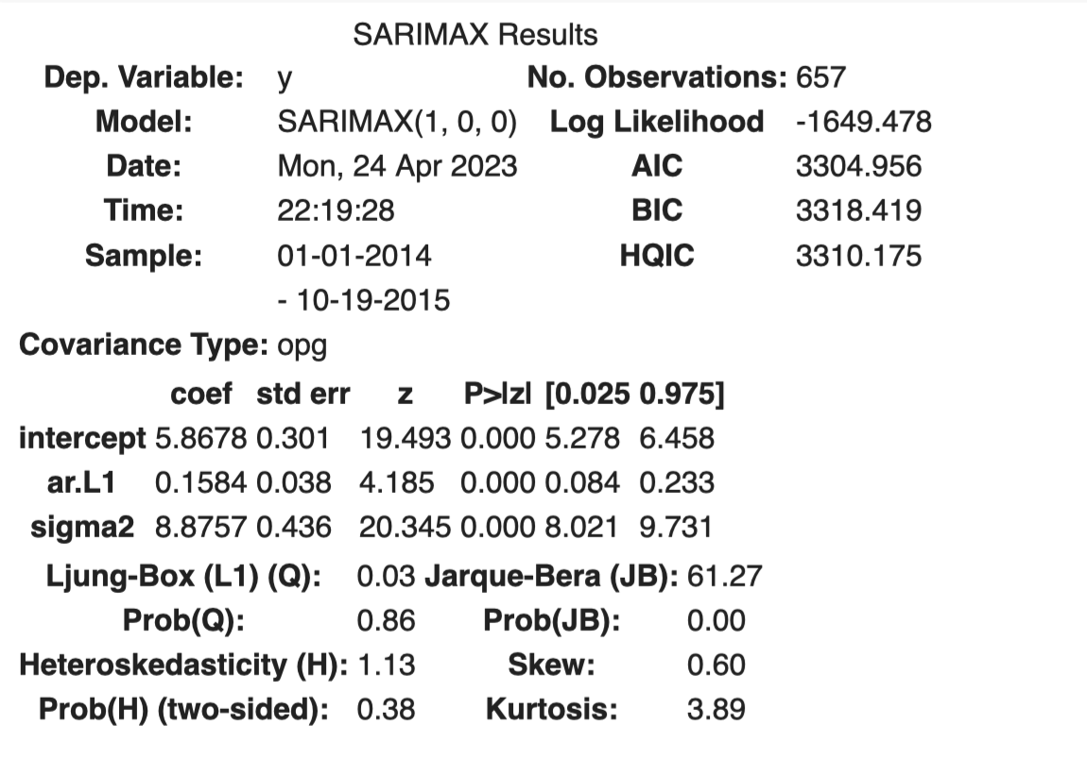
Results from SARIMA model
Seasonal order | (0,0,0,7)
Order | (1,0,0)
rmse | 4.469

Slide 18
Future scope
Expand the analysis done for ‘Beverages’ category to all the other categories.
Generate predictions for all the other categories.
Build a real-time system to intake data and make predictions periodically.

Slide 19
Thank you!

